Slide 1
Week 7 Practice

Slide 2
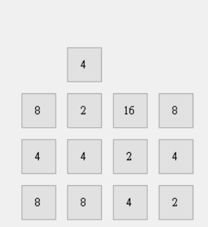
Practice 1 Introduction
A Tetris combined with 2048.
The changeable shape of the square in Tetris will be replaced by a 2048 number square, which is a single square with only numbers (exponent of 2).

Slide 3
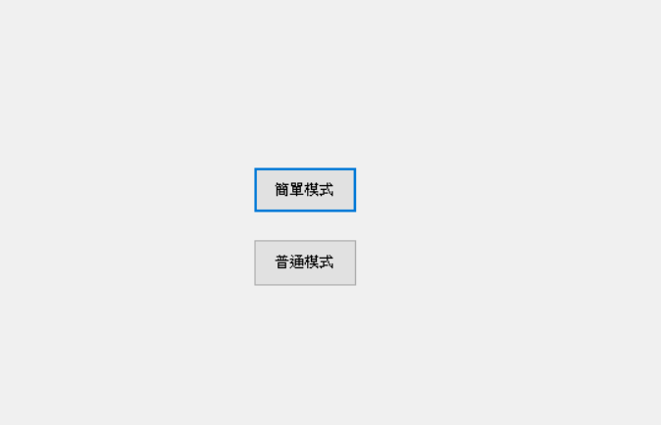
Practice 1 Requirements: Menu
Display the menu and select the mode to enter the game screen of that mode.
Simple
Normal

Slide 4
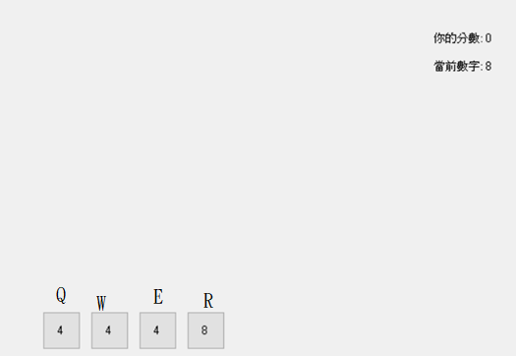
Practice 1 Simple Mode Requirements
Press QWER to determine which column the number is in and drop it.
There is no number at bottom.
Status column on the right
Current number: next number (2, 4, 8 randomly)
Your score: starts from 0 points
Your Score: 0
Current Number: 8

Slide 5
Practice 1 Rule
After dropping the new number.
Step 1. merge(vertical)
When the same numbers are adjacent to each other in the vertical direction, they are merged and the values are added.
Merge first from the bottom and leave no gap with the bottom after merging.
Step 2. delete row(horizontal)
When a row is the same as a certain number, it will be deleted, then the floating number will fall, and the score will be added the square of the number (the same number is 8 will plus the square of 8).
If you can merge after completion, go back to step1.
Step 3. display the result
The results are displayed on the screen.
Note that the process of dropping, merging, and deleting rows does not have to be displayed one by one, as long as display the results after the above steps are completed.

Slide 6
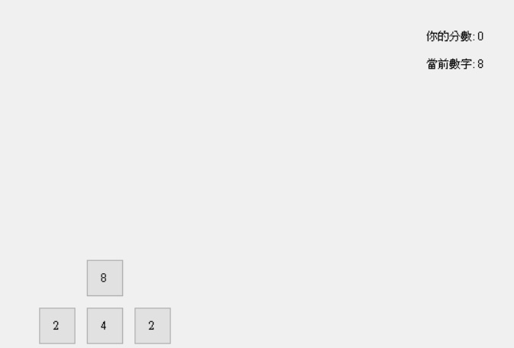
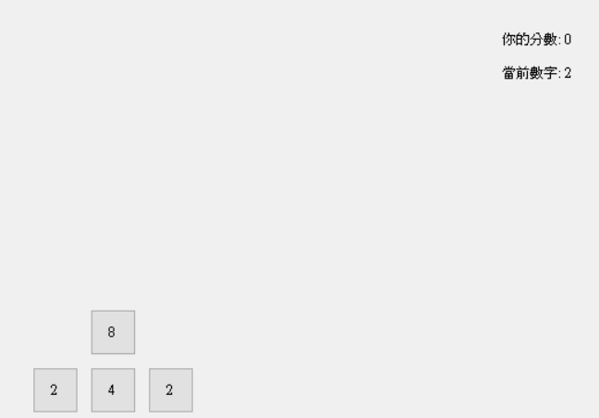
Practice 1 Simple Mode Designated Number
Press a, s, d to change the current number to 2, 4, and 8 respectively.
Press “A”

Slide 7
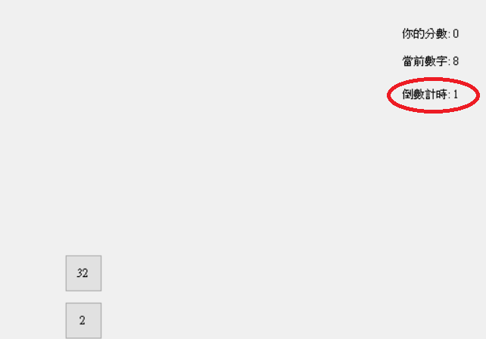
Practice 1 Normal Mode Requirements
The operation and rules are as simple mode.
Status column on the right
Your score
Current number
Countdown: When a number falls or the game starts, it will count down from 3 seconds, and the number will automatically fall in the second column when the time is up.
Please remove designated number function in simple mode.
Your Score: 0
Current Number: 8
Countdown: 1

Slide 8
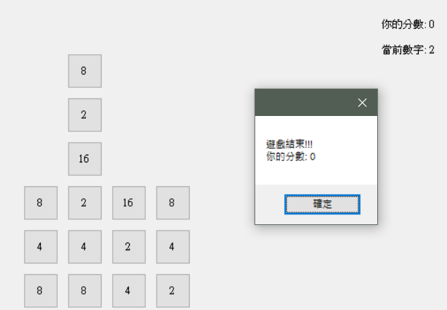
Practice 1 End Game
When the number are stacked to the sixth row (only checked when the result is complete)
The specified MessageBox will pop up, the score will be displayed, and the program will end after pressing OK.
The countdown must be stopped in normal mode.
Game Over!!!
Your Score: 0

Slide 9
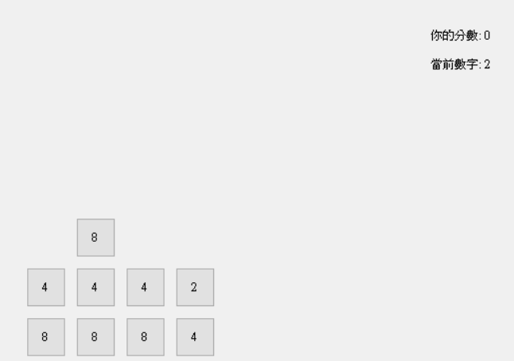
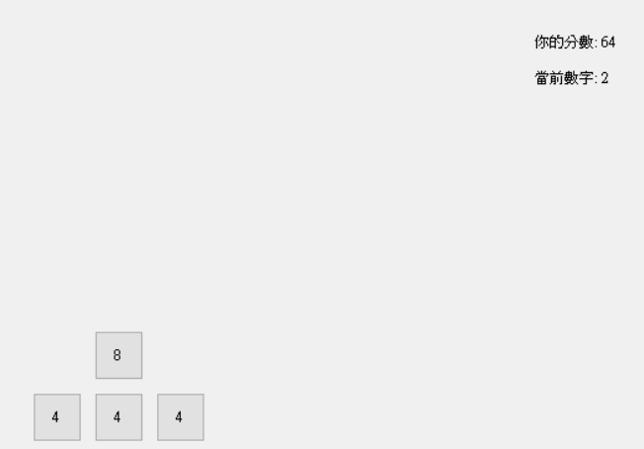
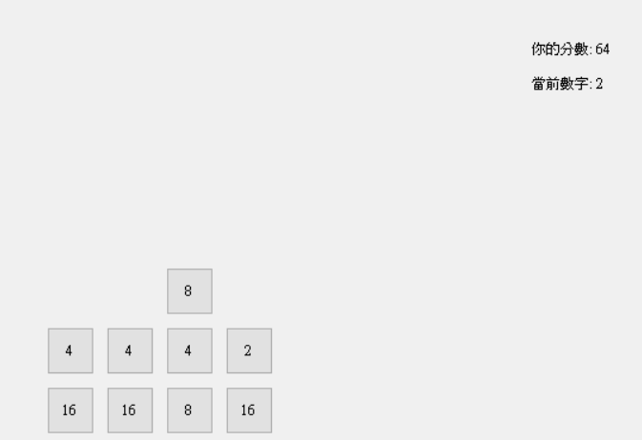
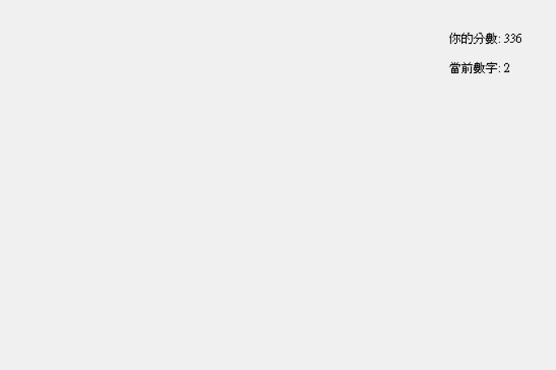
Practice 1 Test
Won't just test these
Press “R”
Press “R”

Slide 10

Practice 2 Introduce
Move the character left and right to pick things up in the game, but there are more settings for “attributes suppressing”.
Water suppresses Fire
Fire suppresses Wood
Wood suppresses Water

Slide 11
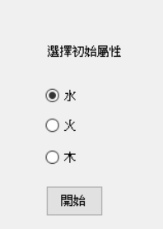
Practice 2 Requirements: Menu
There will be a menu. Select the initial attribute and press start to enter the game screen directly
Choose Initial attribute
water
fire
wood
start

Slide 12
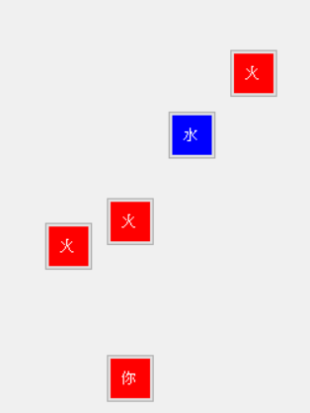
Practice 2 Operation
The player uses the keyboard A, D keys to move left and right in the four columns
When you are in the leftmost column, you will stop at the leftmost column when you press A
When you are in the rightmost column, you will stop at the rightmost column when you press D
1
2
3
4
You
A
D

Slide 13
Practice 2 Requirements: Game Object
Both the enemy and the player have attributes. The word on the player will display “You”, and the enemy will display its attributes (“Water”, “Fire”, “Wood”), and the words are white.
All game objects are implemented with buttons.
Each attribute has a color, and each game object should convert its color to the attribute it holds.
The wood is Color.Green
The water is Color.Blue
The fire is Color.Red,
Enemies fall in four columns
There is one enemy in each column.
Enemies that fall to the bottom (at least more than the player) will be deleted, and another enemy will be added
The enemy's attributes, water, fire, and wood each has a 1/3 probability, and will not be affected by the attributes of other columns or the enemy on the same column.

Slide 14
Practice 2 Enemy
The collision between the player and the enemy
Suppressing enemy(The water attribute player encounters the fire attribute enemy)
Score +5
The enemy disappears after being hit
The player’s attribute becomes the enemy’s
Suppressed by enemy
Score -5
The enemy disappears after being hit
Same Attribute
Nothing happens
When overlapping, the player must be displayed above the enemy
The player only collides with enemies in same column

Slide 15
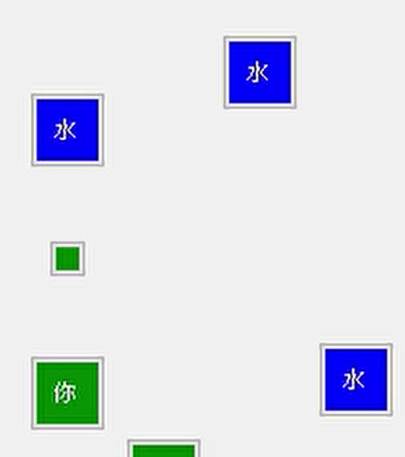
Practice 2 Bullet
Pressing the w key to shoot a bullet with the player’s own attribute
The bullet will be shot from the player and flies upwards
1 second cooldown
Bullets need to have different colors according to their attributes
The collision between the bullet and the enemy
The bullet and the enemy disappears
Suppressing enemy, score +2
Suppressed by enemy, score -2
Bullets that have been shot will not change their attributes when the player changes their attribute
The bullets only collides with enemies in the same columns

Slide 16
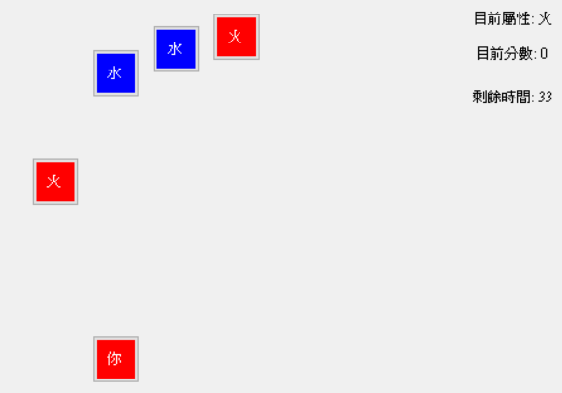
Practice 2 Requirements: Status Display
Status column on the right
Countdown: 60 seconds
Current score: 0 points start
Current attribute: player attributes
The current attribute will be the initial attribute you selected in the menu at the beginning.
Current Attribute: Fire
Current Score: 0
Countdown: 33

Slide 17

Practice 2 Requirements: Size, Distance
Size
Player, Enemy is 40x40。
Bullet is 20x20
Distance
Width of column is 50。
The distance the enemy falls from the top to the bottom is about y=400。
Player
Always at y=300
The player’s horizonal position is initially in the second column from the left (the leftmost is the first column)
Bullets, players, and enemies in the same column should not exceed that column

Slide 18
Practice 2 Requirements: Speed, Inheritance
Enemies and bullets need to use inheritance (see your code).
Enemies and bullets’ speed will be different (implemented with inheritance) 。
Water: 10/100ms
Fire: 20/100ms
Wood: 30/100ms
This means you will use a 100ms timer.

Slide 19
Practice2 Basic Unit
The above length units are integer 1, which is the basic unit of the form.
Note that the basic units of button and label on the form will be different, so this practice uses the button as the game object. The game objects are the player, bullets, and enemies.
The display of the game status will not have the problem of aligning with other objects, just use label.

Slide 20
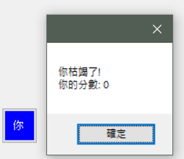
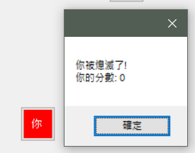
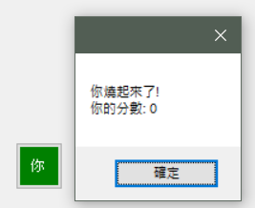
Practice 2 End Game
When the score is negative, the character will display a different MessageBox due to the player’s own attributes,
At the same time
Reset score to 0
Interrupt the countdown
Click OK to end the program
You are drained!
Your Score: 0
You are extinguished!
Your Score: 0
You are burning!
Your Score: 0

Slide 21
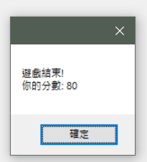
Practice 2 Time Up
When the game ends after 60 seconds,
Interrupt the countdown
Show MessageBox, display final score, and click OK to end the program
。
Game Over!!!
Your Score: 80

Slide 22
Demo
Practice 2
Due to the recording software, MessageBox cannot be displayed.

